Slide 1
Traffic Management System
Built using Java
Done by: Aswanth.P
Reg. No: URK24CS7127

Slide 2
Introduction
This program is designed to streamline the monitoring and management of vehicular movement within a city or region. It leverages a MySQL database connected via JDBC (Java Database Connectivity) to store, retrieve, and manage critical information such as vehicle registrations, traffic signals, and traffic violations.

Slide 3
Scope of a Project
By integrating a database-driven approach with a user-friendly interface to provide an efficient and centralized platform for managing traffic-related information using Java and MySQL. The system’s scope covers the registration and tracking of vehicles, maintenance of traffic signal data, and recording of violations committed by drivers. It supports essential CRUD operations—allowing authorized users to create, read, update, and delete records directly through a graphical interface.

Slide 4
Tools Used
Visual Studio Code
Java(JDK 8>) & SWING
MySQL
Database Connectivity(JDBC)

Slide 5
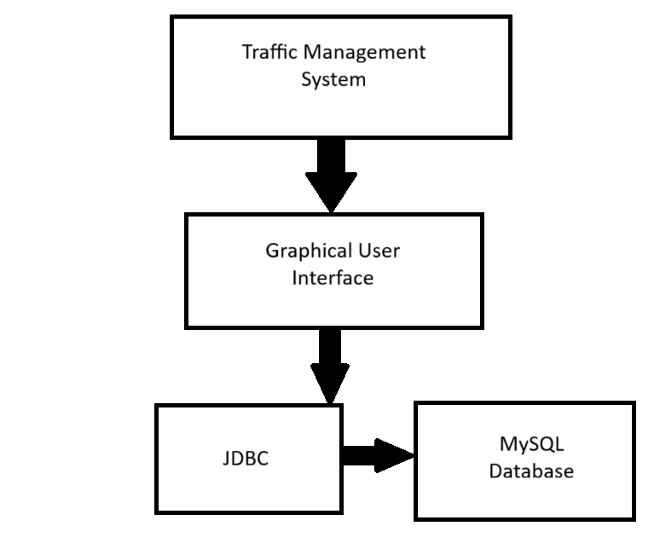
Architecture

Slide 6
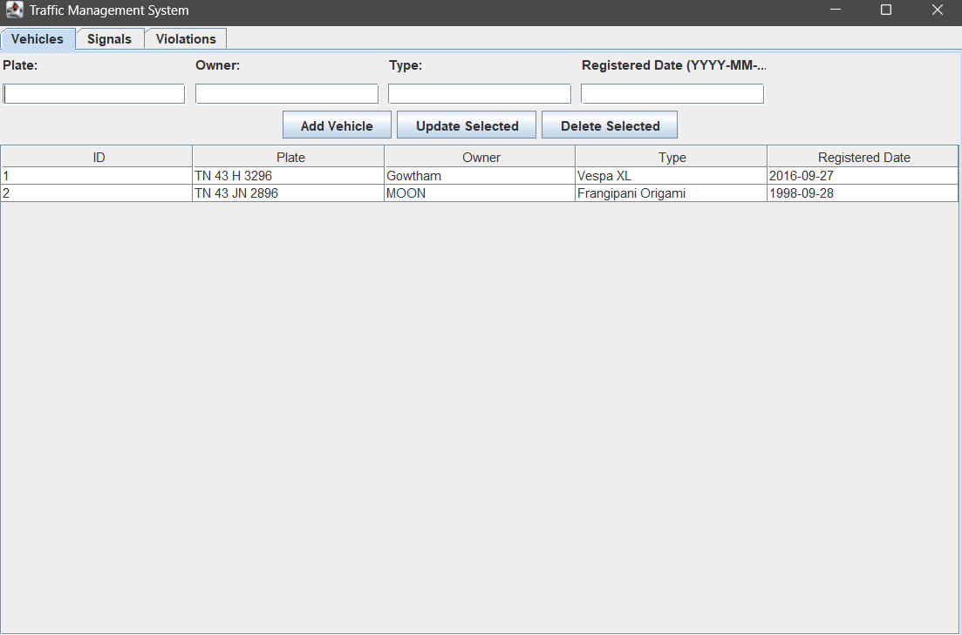
Output Screenshot

Slide 7
Conclusion
The Traffic Management System efficiently manages vehicle, signal, and violation records using Java and MySQL. It simplifies data handling through a user-friendly GUI and reliable database connectivity via JDBC. The system enhances accuracy, reduces manual work, and provides a scalable foundation for future traffic automation features and finally, the planned design and code was implemented and the project was completed and it executed successfully.

